Slide 1
AI-SW Hackathon
Tampere University

Slide 2
Group: pyva_2.0
Team Members
Abrar Morshed
Sheikh Mohammad Jubaer
Challenge B

Slide 3
Challenge B requirements
Objective: Analyze agricultural event data from Maaseutuverkosto.fi/AgriHubi.fi using AI to assess significance, distribution, and future needs, aligning with the EU's CAP plan goals.
Key Tasks:
Requirement 1: Event Analysis
Assess event alignment with the CAP plan goals.
Examine event distribution among stakeholders and themes.
Identify the number of events related to key CAP themes like sustainability, technological development, and rural vitality.
Extract and analyze keywords and their frequencies.
Requirement 2: CAP Analysis
Develop insights to anticipate future event focuses and recommend topics.
Requirement 3: Search Functionality
Implement a free-text search for event data, displaying results in a list.

Slide 4
What we achieved?
We completed all the requirements of Challenge B.
We cleaned and structured the messy dataset.
We integrated our project with gpt-4o-mini with OpenAPI key by implementing a chatbot.

Slide 5
Data Pre-processing
Firstly, we convert the csv file to excel file.
Then make the columns delimited so that we can easily scan the relevant data.
Then we remove some irrelevent words for example, html tags.
Dataset
2_tapahtumat_agrihubi.csv (Given)
2_Suomen CAP-suunnitelma.pdf (Given)
Technologies Used
Python Streamlit (Backend and Fronend)
OpenAI api key
VS Code + PyCharm

Slide 6
Tools and Technologies
Python Streamlit (Backend and Fronend)
OpenAI api key (gpt-4o-mini)
VS Code + PyCharm
Libraries:
pandas
numpy
matplotlib
nltk
streamlit
pdfplumber
openpyxl

Slide 7
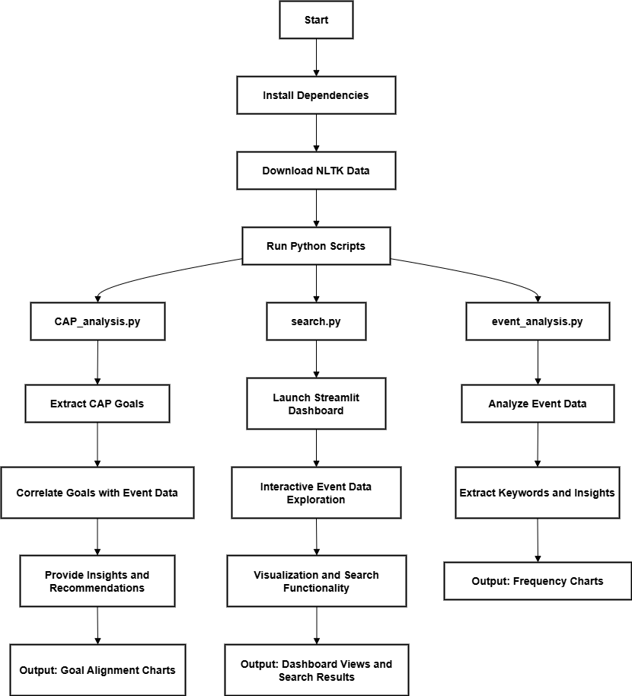
Flow diagram

Slide 8
Requirement 1: Event Analysis
Task: Answer questions about event data alignment with CAP plan goals.
Approach:
Data Cleaning and Preprocessing:
Load the 2_tapahtumat_agrihubi.csv file using pandas.
Clean and format the data, ensuring keywords, stakeholders, and themes are extracted.
These are our chosen columns from the dataset:
Otsikko: Title
Tiivistelmä: Summary
Sisältö: Content
Aiheet: Topics
Avainsanat: Keywords
Tapahtuman kohderyhmä: Target audience of the event
Tyyppi: Type
Hanketiedot: Project details

Slide 9
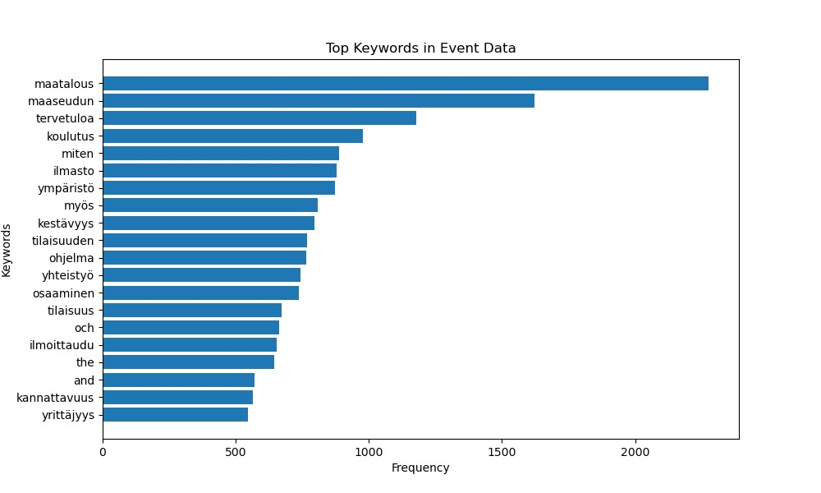
Requirement 1: Event Analysis
Output

Slide 10
Requirement 1: Event Analysis
1. How well do the events support the current CAP plan goals?
The keywords strongly indicate alignment with CAP (Common Agricultural Policy) goals:
"maatalous" (agriculture): The most frequent keyword (2276 mentions), indicating a dominant focus on agricultural development.
"ilmasto" (climate, 879) and "kestävyys" (sustainability, 797): Highlight efforts toward addressing climate challenges and promoting sustainable practices.
"ympäristö" (environment, 872): Indicates focus on environmental themes, directly supporting CAP’s sustainability objectives.
"maaseudun" (rural, 1622): Strong emphasis on rural vitality, a critical aspect of CAP.
"osaaminen" (skills, 737) and "koulutus" (education, 979): Indicate focus on knowledge transfer and capacity building, which aligns with goals related to technological development and innovation.
"yhteistyö" (collaboration, 743) and "yrittäjyys" (entrepreneurship, 545): Suggest support for stakeholder cooperation and fostering rural entrepreneurship, promoting economic growth and resilience.
These keywords collectively demonstrate that the events strongly support CAP goals, especially in sustainability, rural vitality, and capacity building.

Slide 11
Requirement 1: Event Analysis
2. How are events distributed among different stakeholders and themes?
The keywords provide clues about stakeholder involvement and thematic focus:
Stakeholders:
"yhteistyö" (collaboration): Suggests events facilitating partnerships among stakeholders.
"yrittäjyys" (entrepreneurship): Indicates events engaging business owners and innovators.
"osaaminen" (skills): Points to educational and skill-building efforts, likely targeting a diverse audience, including rural communities, students, and professionals.
Themes:
Sustainability and Climate: "ilmasto," "ympäristö," and "kestävyys" indicate a strong thematic focus.
Rural Development: "maaseudun" and "yrittäjyys" point to rural vitality and entrepreneurial support.
Education and Training: "koulutus" and "osaaminen" highlight a significant focus on knowledge dissemination and skill-building.
Economic Growth: "kannattavuus" (profitability, 563) suggests themes related to economic viability and growth.
Further distribution analysis would require linking these themes to individual events and their associated stakeholders using metadata like "Tapahtuman kohderyhmä" or "Aiheet."

Slide 12
Requirement 1: Event Analysis
3. How many events are related to key CAP themes, such as sustainability, technological development, or rural vitality?
Based on the keyword frequencies:
Sustainability: Keywords like "ilmasto" (879), "kestävyys" (797), and "ympäristö" (872) suggest a significant number of events related to sustainability.
Technological Development: While explicit technological terms are absent, "osaaminen" (737) and "koulutus" (979) imply events aimed at skill development and education, which indirectly support technological growth.
Rural Vitality: "maaseudun" (1622) and "yrittäjyys" (545) strongly indicate a substantial focus on rural vitality and entrepreneurship.
Exact counts require event-level classification using metadata from "Aiheet" or "Sisältö."

Slide 13
Requirement 1: Event Analysis
4. What keywords and their frequencies can be identified in the data?
The updated keywords and frequencies provide insights into recurring themes:
High Relevance to CAP Goals:
"maatalous" (2276): Agriculture
"maaseudun" (1622): Rural vitality
"ilmasto" (879), "kestävyys" (797), "ympäristö" (872): Sustainability and environment
"osaaminen" (737), "koulutus" (979): Education and skills
"yhteistyö" (743): Collaboration
"yrittäjyys" (545): Entrepreneurship
General/Event-related:
"ohjelma" (765): Program
"tilaisuus" (671): Event/opportunity
"ilmoittaudu" (655): Registration
Economic Focus:
"kannattavuus" (563): Profitability

Slide 14
Requirement 2: Event Analysis
Task: Anticipate future event focuses and recommend topics.
Approach:
Extract insights from CAP goals in the 2_Suomen CAP-suunnitelma.pdf file.
Use trends and themes in event data to recommend topics.

Slide 15
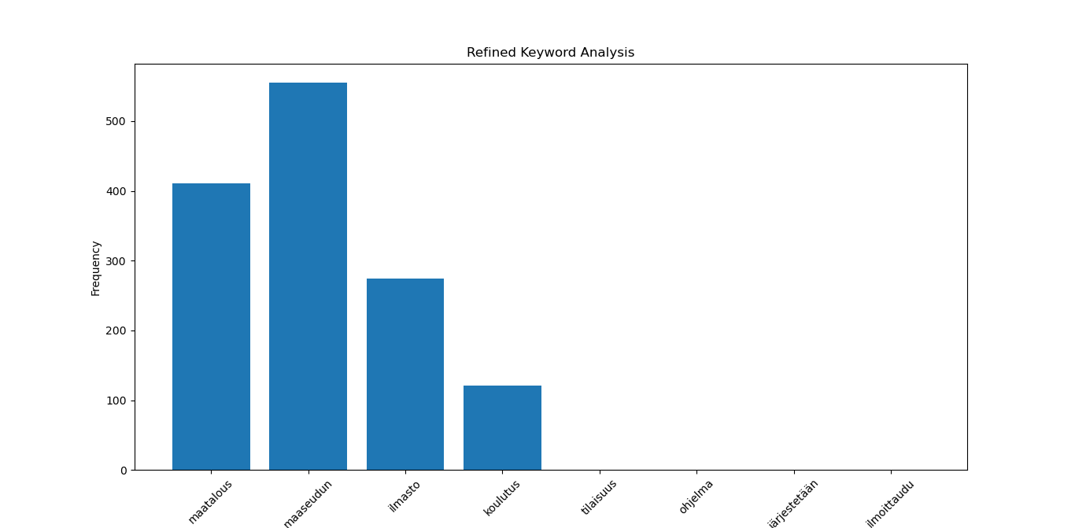
Requirement 2: CAP Analysis
Output

Slide 16
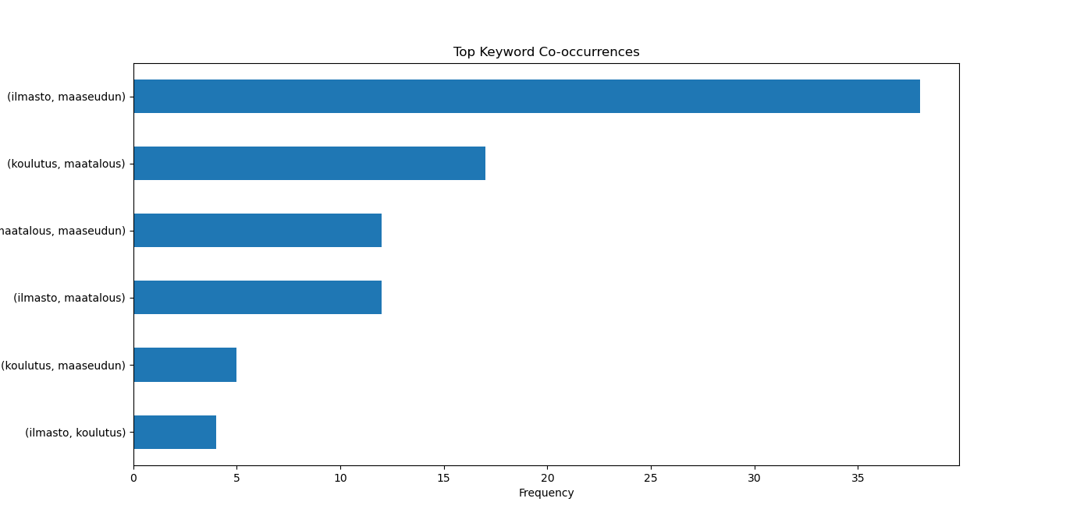
Requirement 2: CAP Analysis
Output

Slide 17
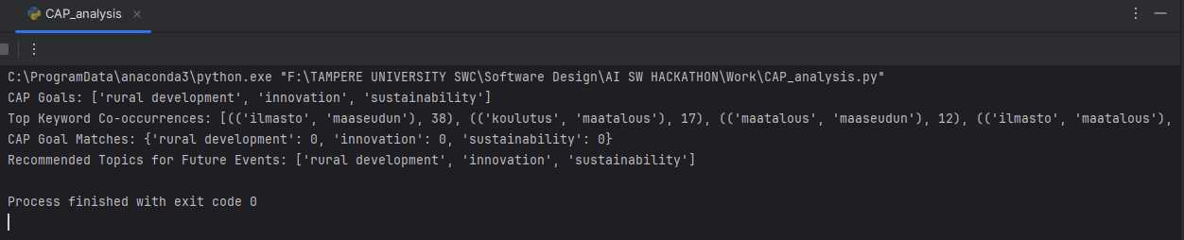
Requirement 2: CAP Analysis
Output
C:\ProgramData\anaconda3\python.exe "F:\TAMPERE UNIVERSITY SWC\Software Design\AI SW HACKATHON\Work\CAP_analysis.py"
CAP Goals: ['rural development', 'innovation', 'sustainability']
Top Keyword Co-occurrences: [(('ilmasto', 'maaseudun'), 38), (('koulutus', 'maatalous'), 17), (('maatalous', 'maaseudun'), 12), (('ilmasto',
'maatalous'), 12), (('koulutus', 'maaseudun'), 5), (('ilmasto', 'koulutus'), 4)]
CAP Goal Matches: {'rural development': 0, 'innovation': 0, 'sustainability': 0}
Recommended Topics for Future Events: ['rural development', 'innovation', 'sustainability']
Process finished with exit code 0

Slide 18
Requirement 2: Event Analysis
1. Refined Keyword Analysis
The bar chart shows the frequency of keywords that were identified as significant from the event data. Here's the breakdown:
maaseudun (rural): This is the most frequently used keyword, indicating a strong emphasis on rural themes in past events.
maatalous (agriculture): Highly frequent, showing a focus on agricultural themes.
ilmasto (climate): Moderately frequent, indicating attention to climate-related issues but less so compared to rural and agriculture topics.
koulutus (education/training): Lower frequency, suggesting fewer events specifically focused on educational programs.
Other terms like järjestetään (organized), tilaisuus (event), and ohjelma (program) are more generic and likely tied to event logistics rather than themes.

Slide 19
Requirement 2: Event Analysis
2. Top Keyword Co-occurrences
The co-occurrence chart highlights the pairs of keywords that frequently appear together:
(ilmasto, maaseudun) (climate, rural) is the most frequent co-occurrence, suggesting a focus on rural climate issues.
(maatalous, koulutus) (agriculture, education): Indicates events connecting agriculture with training or capacity building.
Other notable pairs:
(ilmasto, maatalous) (climate, agriculture)
(maaseudun, maatalous) (rural, agriculture)
These pairs reveal the overlapping focus areas in past events.

Slide 20
Requirement 2: Event Analysis
Future Recommendations
More events focused on climate and sustainability.
Increase training and educational opportunities, especially in advanced technologies and rural development.
Combine rural and climate themes to address overlapping priorities.
Introduce innovation-focused topics in line with CAP goals.

Slide 21
Requirement 3: Search Function
Task: Allow users to search event data via a free-text field.
Approach:
Create a Python Streamlit app for backend functionality.
Use pandas to filter event data based on user input.

Slide 22
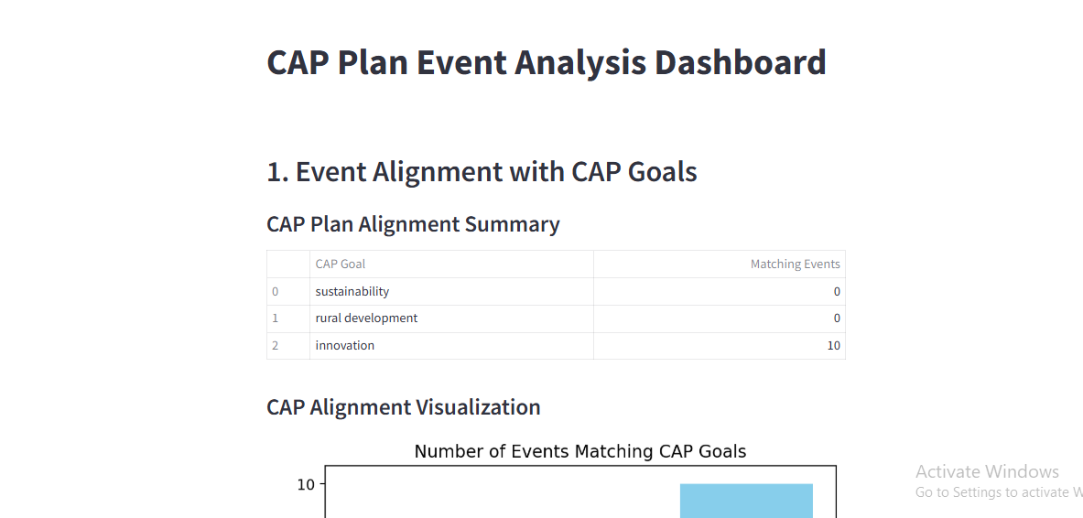
Requirement 3: Search Function

Slide 23
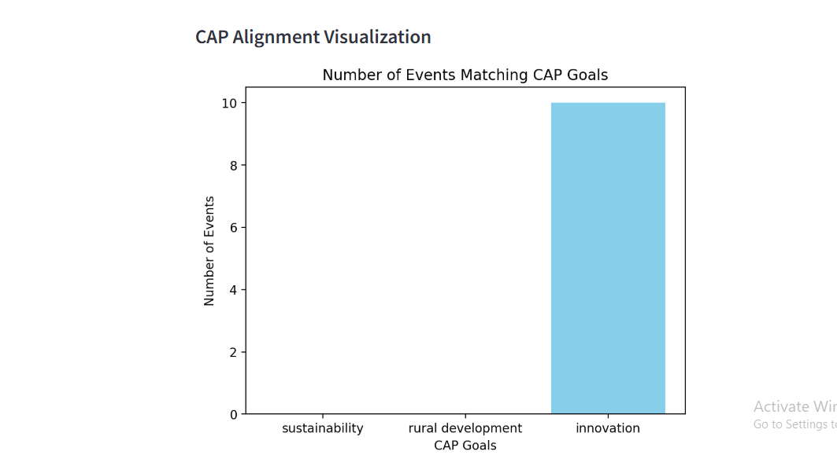
Requirement 3: Search Function

Slide 24
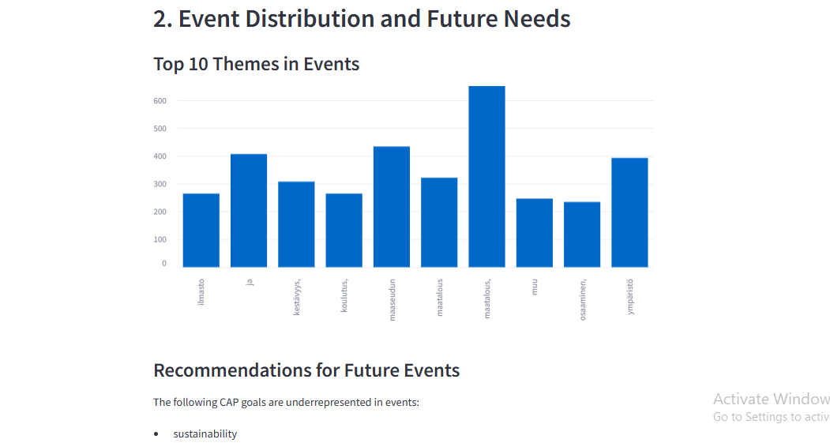
Requirement 3: Search Function

Slide 25
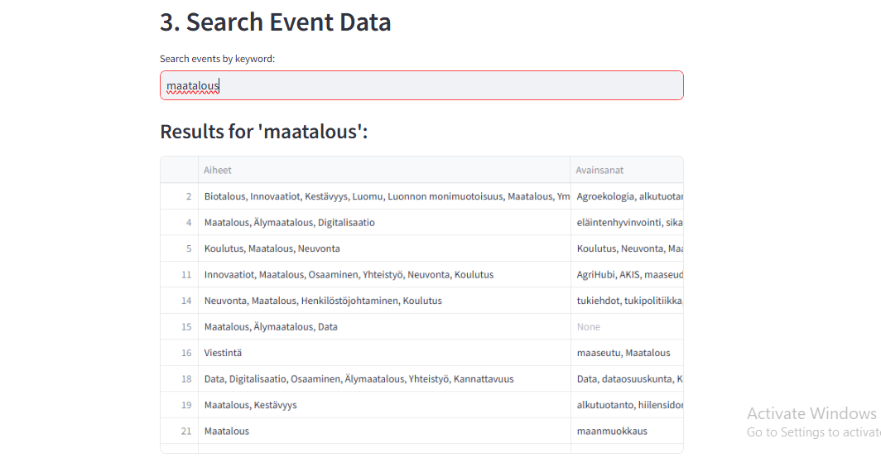
Requirement 3: Search Function

Slide 26
Demo

Slide 27
Thank you

